Slide 1



Vertical Slice Architecture
Jimmy Bogard
@jbogard
github.com/jbogard
jimmybogard.com

Slide 2
Traditional n-tier
UI Layer
Business Logic Layer
Data Access Layer
Database

Slide 3
“DDD”-style n-tier
UI Layer
Services
Domain
Repository

Slide 4
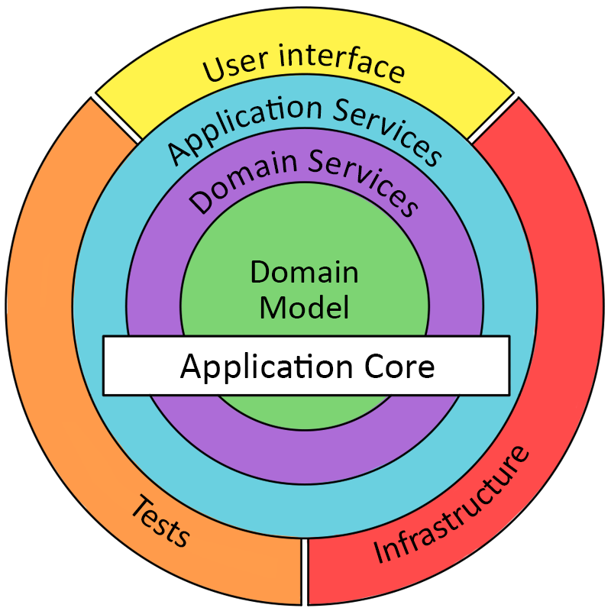
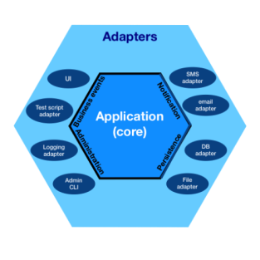
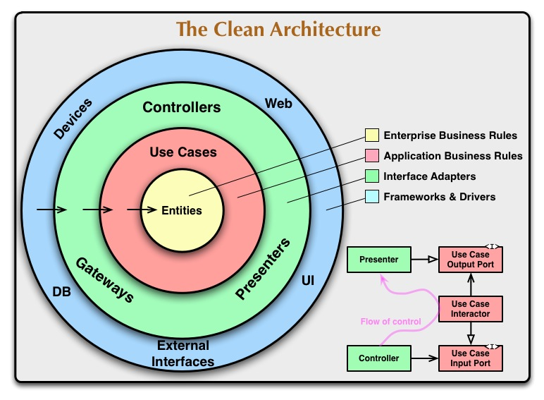

Slide 5
Purported Benefits
Independent of frameworks
Testable
Independent of UI
Independent of database
Independent of outside dependencies

Slide 6
Verdict: False

Slide 7
Organizing by layer
Person.cs
PersonController.cs
PersonService.cs
PersonRepository.cs

Slide 8
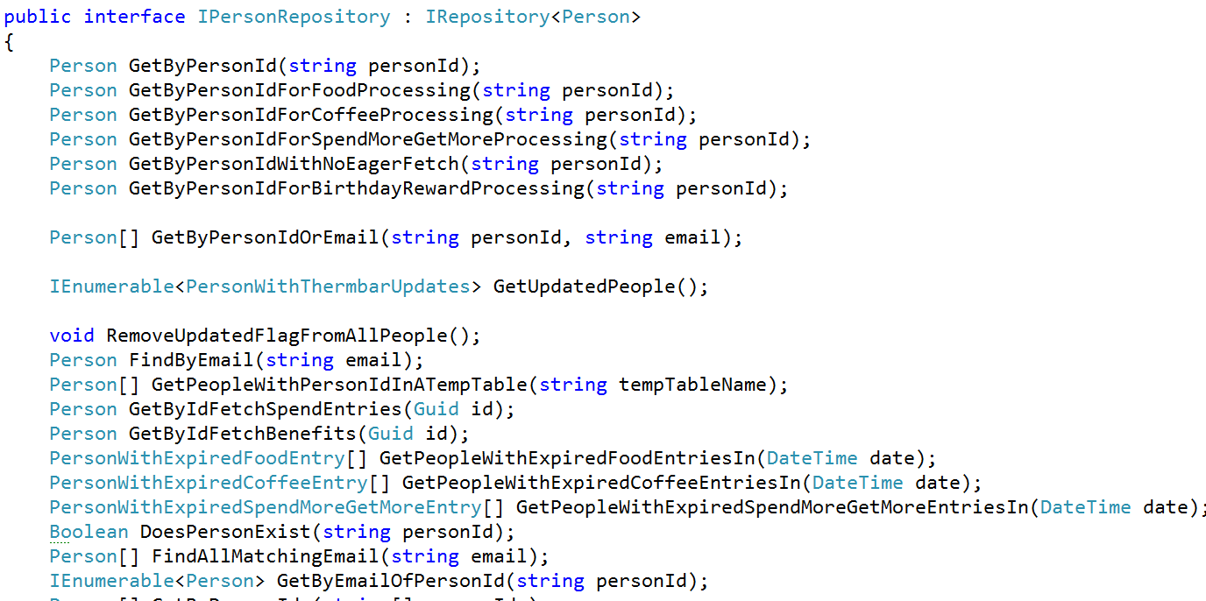
Inmates blew up the asylum

Slide 9
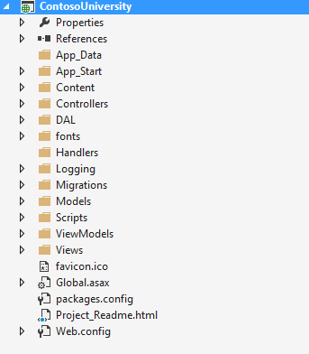
Areas of change

Slide 10
PersonController
StudentController
Index
Edit
Create
Search
Enroll
Create
PersonService
StudentService
Get
Edit
Create
Search
Enroll
Create
PersonRepository
StudentRepository
Find
Get
Save
Find
Get
Save

Slide 11
Web App Characteristics
Web App
Safe
Idempotent
Unsafe
Not idempotent
GET
Query
POST
Command

Slide 12
CQRS: Two models where once there was one

Slide 13
CQRS to the Rescue
Queries
Commands

Slide 14
Axes of change
View Unapproved Invoices
Approve Invoice
Reject Invoice
UI Layer
Domain Objects
Repository
Database

Slide 15
Vertical Slice Architecture Model and organize application architecture around axes of change, vertical slices

Slide 16
Vertical Slices

Slide 17
Move code to single place

Slide 18
Move service methods to classes
Invoice Service
void Approve()
ApproveInvoice {}
void Reject()
RejectInvoice {}
void Flag()
FlagInvoice {}

Slide 19
Modeling requests
Input
Request Handler
Output

Slide 20
Request/Response with MediatR
IRequest<T>
IRequest
Handler
<TRequest, TResponse>
TResponse
Task<TResponse> Handle(
TRequest request) {
}

Slide 21
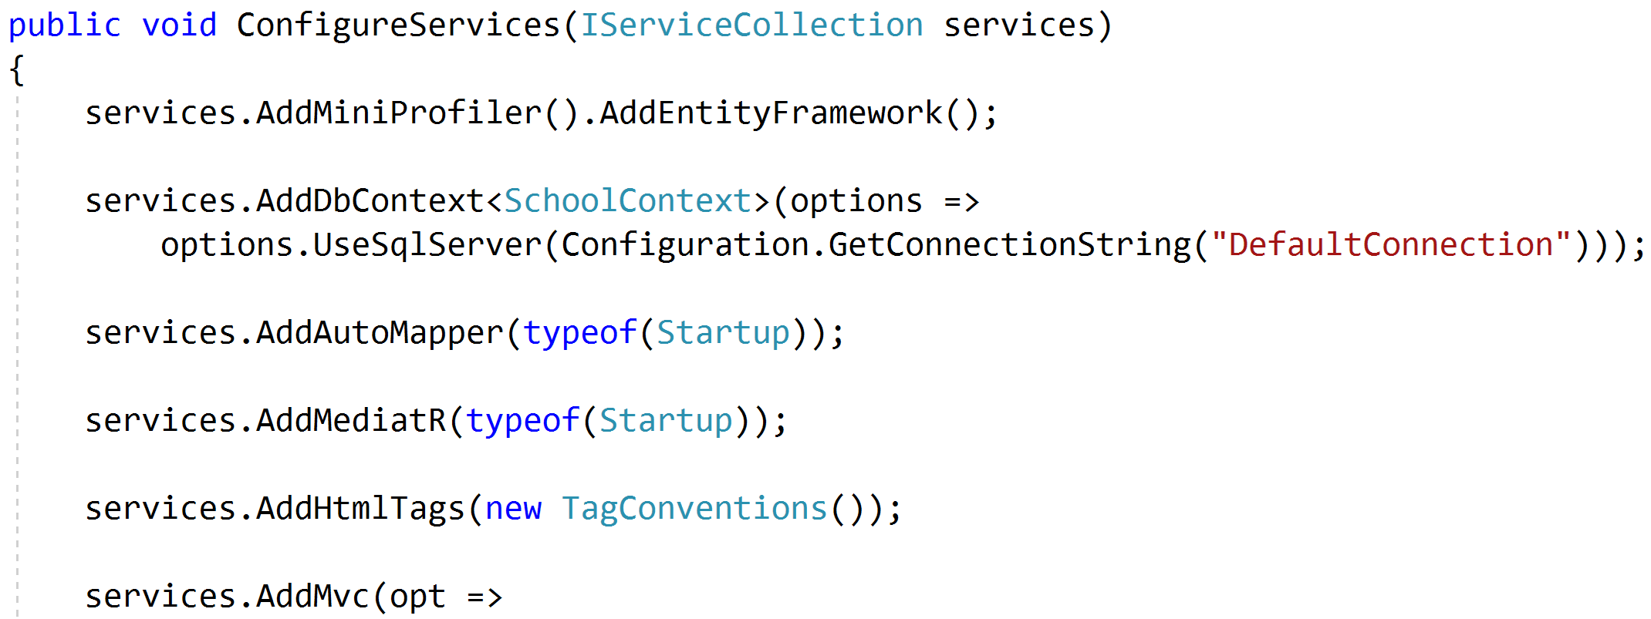
Registering MediatR

Slide 22
Commands and Queries
Web App
GET
Query
Handler
Response
Query
POST
Command
Handler
Response
Command

Slide 23
One model in, one model out
Query
Handler
Response
Command
Handler
Response

Slide 24
Complete encapsulation
Request
Response

Slide 25
Areas of change

Slide 26
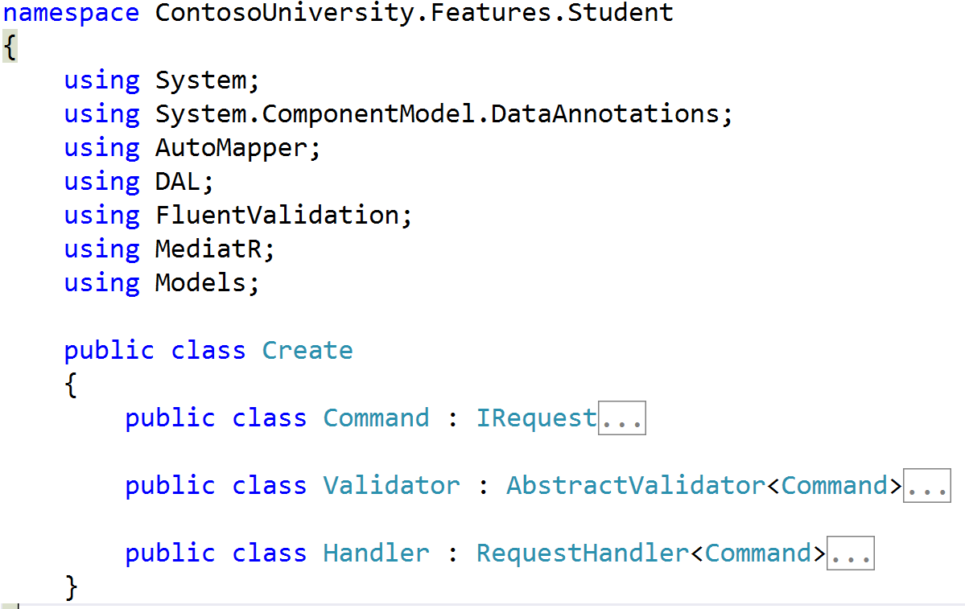
Collapsing Models

Slide 27
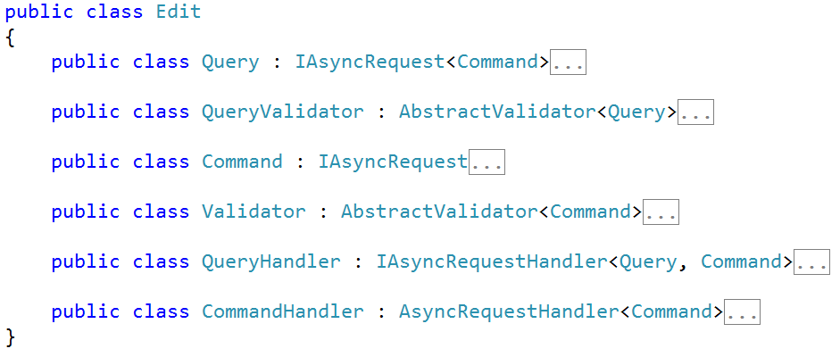
Collapsing Features

Slide 28
Modeling Queries
Query
Handler
Response

Slide 29
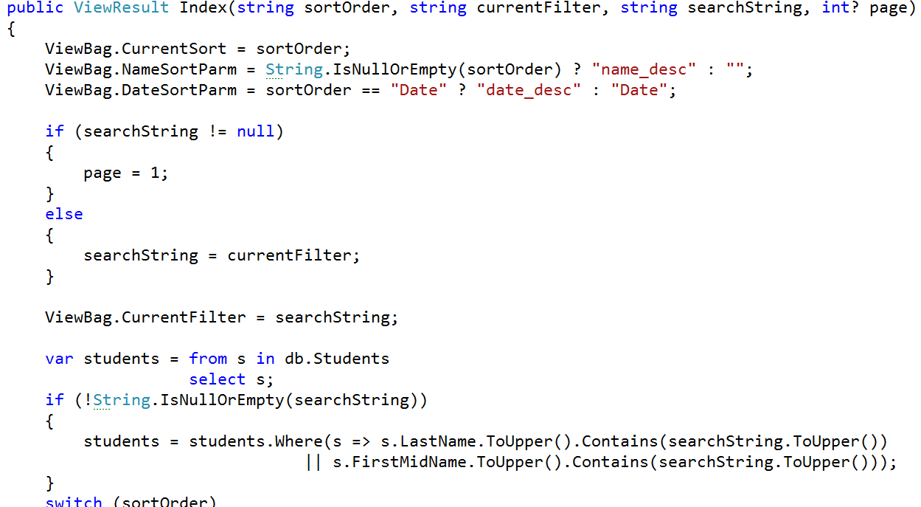
Modeling Queries

Slide 30
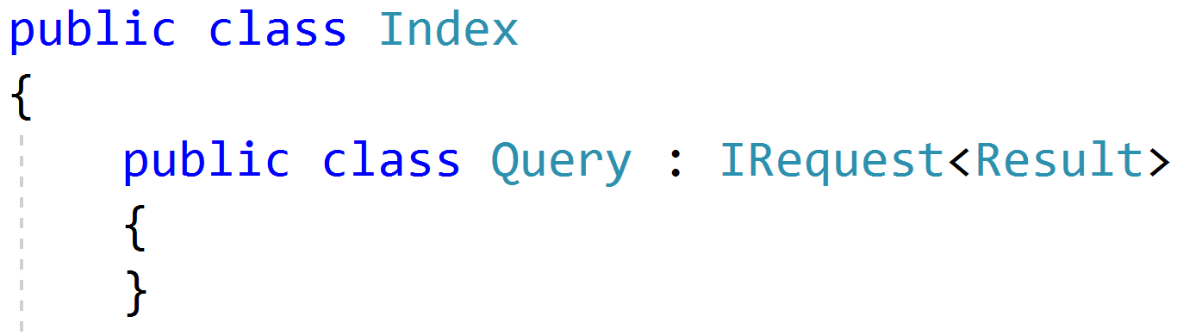
Simple Queries

Slide 31
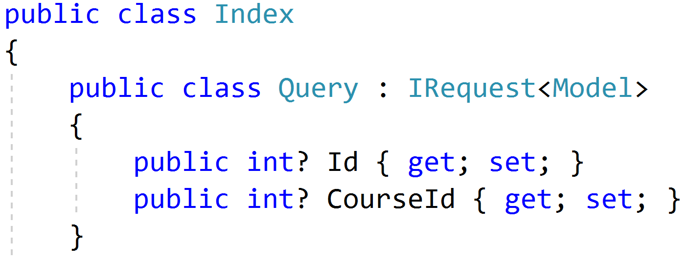
Parameterized Queries

Slide 32
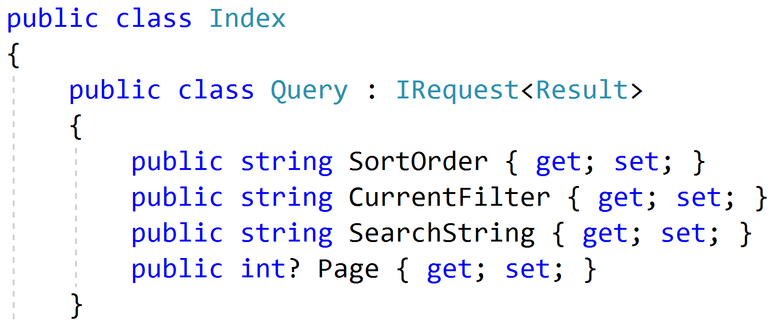
Paging/Sorting/Filtering

Slide 33
Modeling Responses
Query
Handler
Response
View

Slide 34
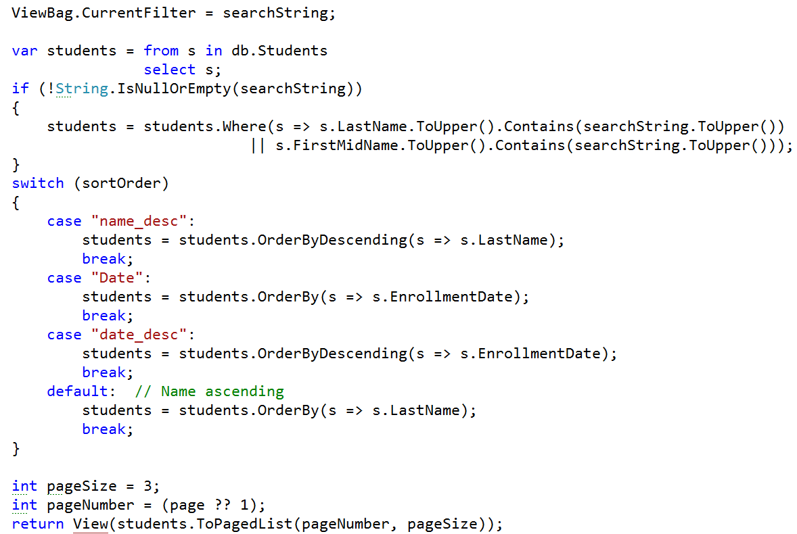
Modeling outputs

Slide 35
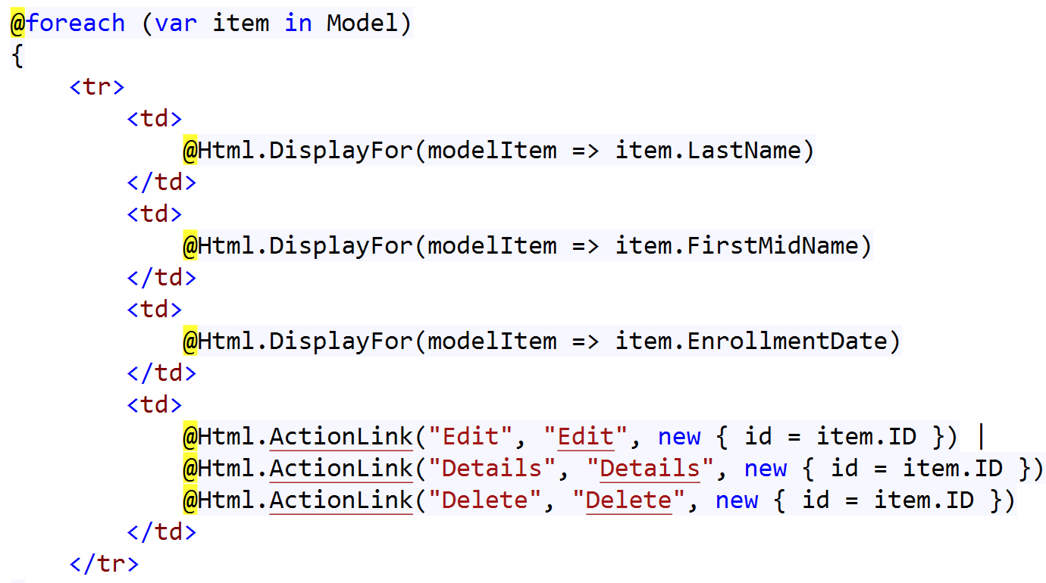
Modeling outputs

Slide 36
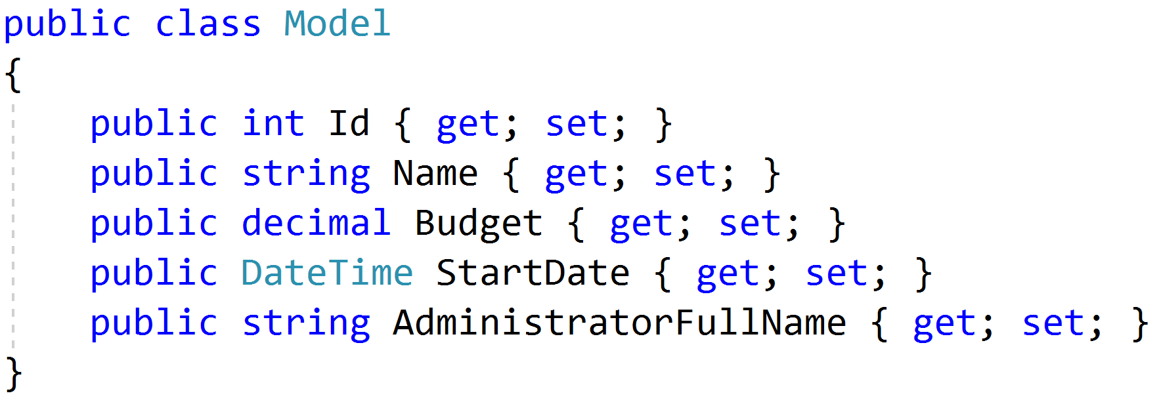
Simple Response

Slide 37
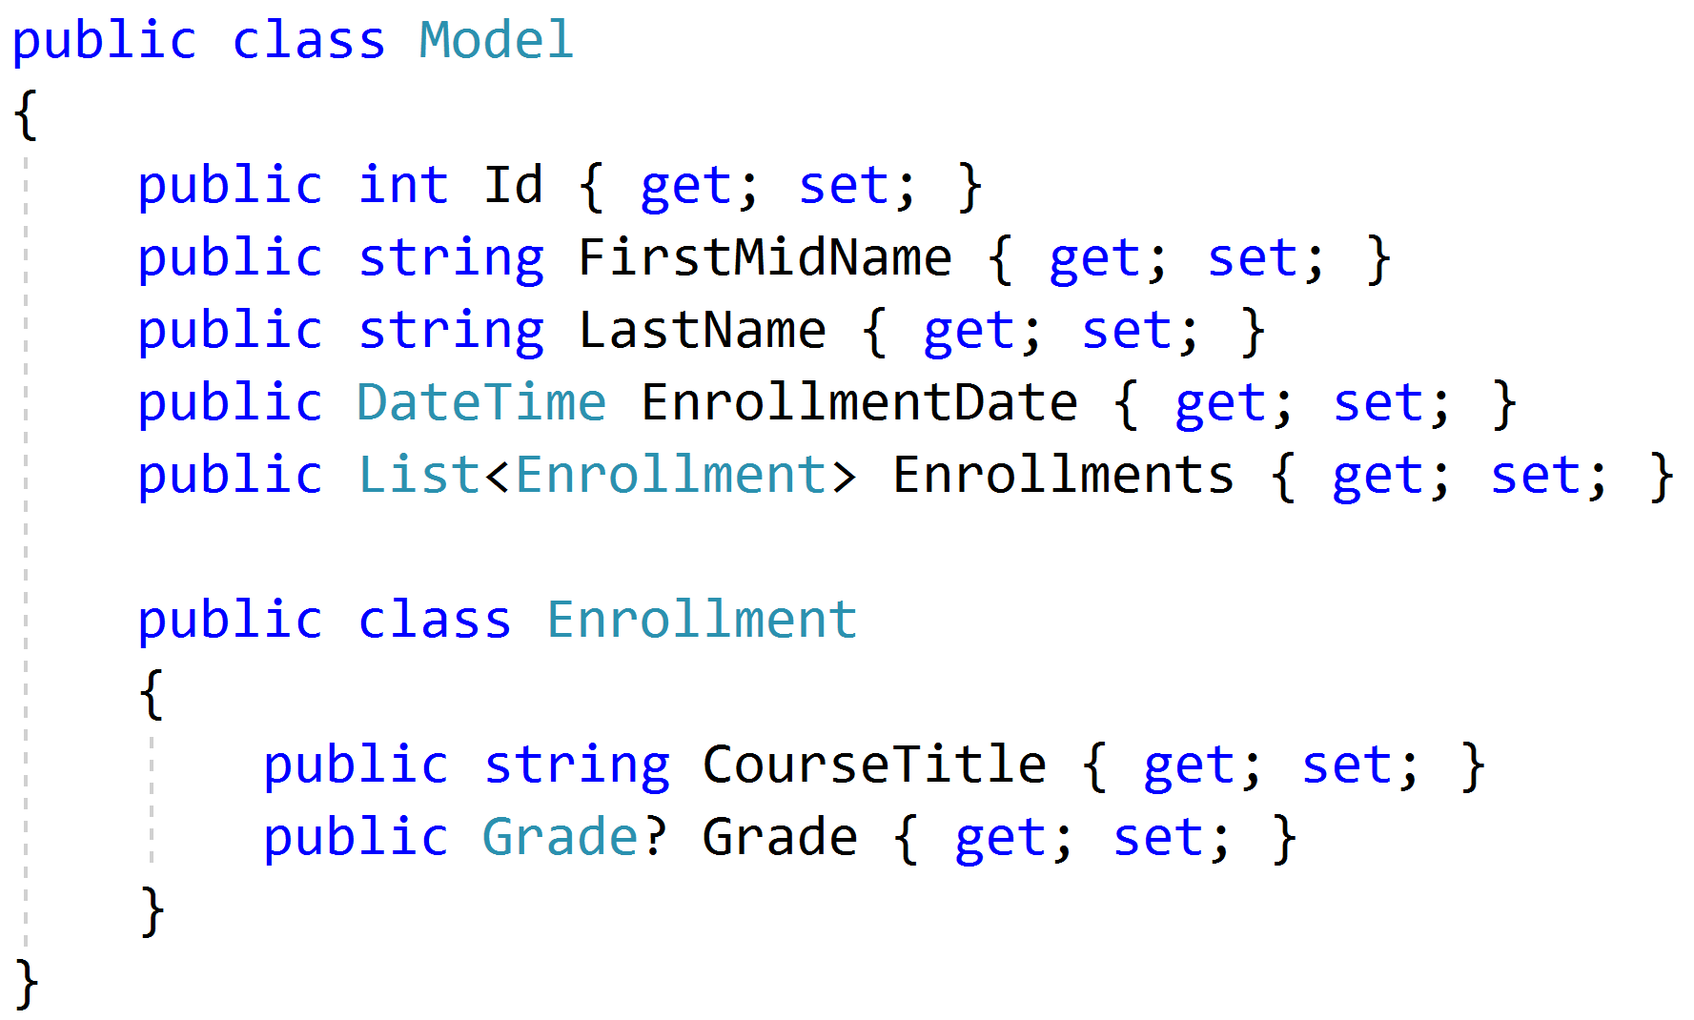
Complex Response

Slide 38
Modeling Query Handlers
Query
Handler
Response

Slide 39
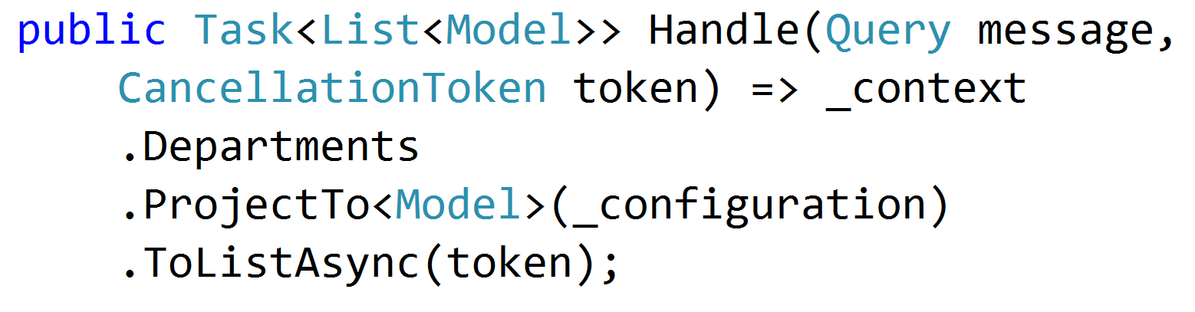
Simple AutoMapper Projections

Slide 40
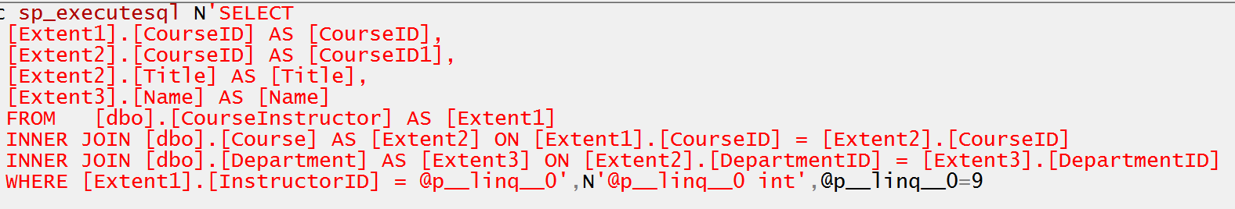
Projecting Query Result

Slide 41
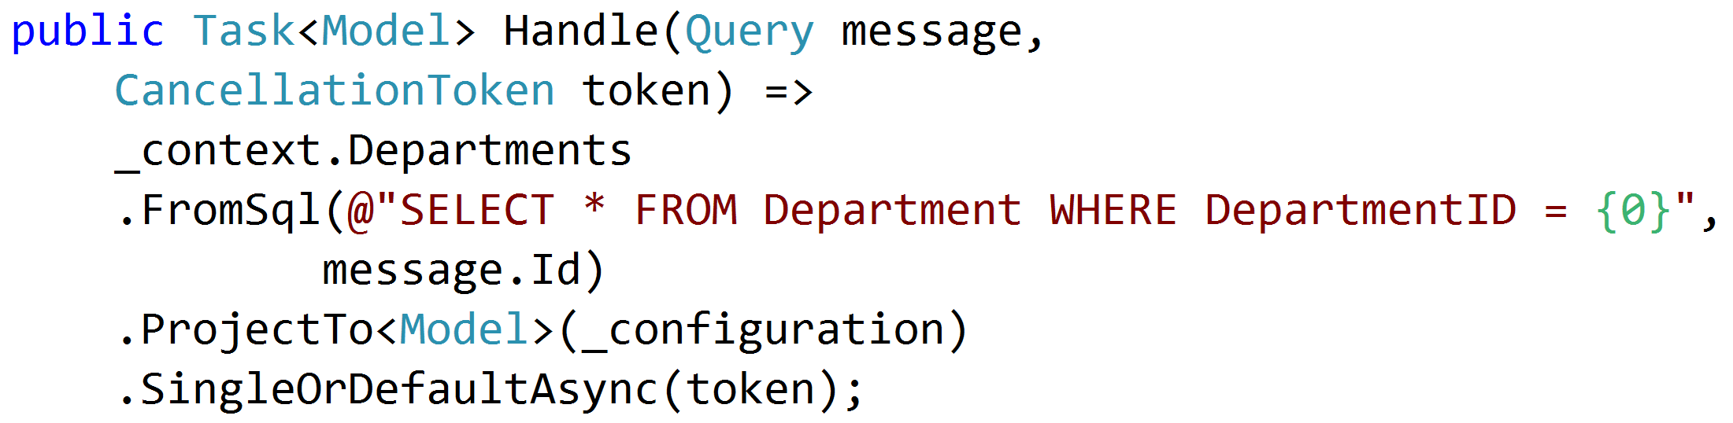
SQL Projections

Slide 42
Encapsulated Logic
Query
ORM
Response
Query
MicroORM
Response
Query
HttpClient
Response
Query
MeatGrinder
Response

Slide 43
Duplicate Query Logic
Query
Handler
Response
Common
Query
Handler
Response
Common

Slide 44
Refactor
Query
Handler
Response
Class?
Function?
Extension Method?
Common
Query
Handler
Response

Slide 45
Modeling Commands
Command
Handler
Response

Slide 46
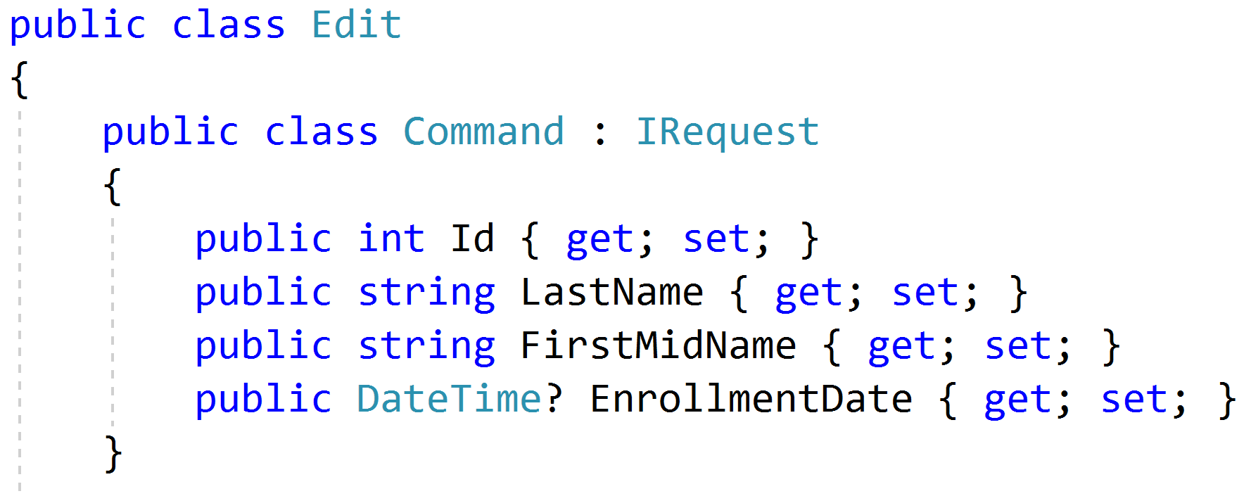
Simple Commands

Slide 47
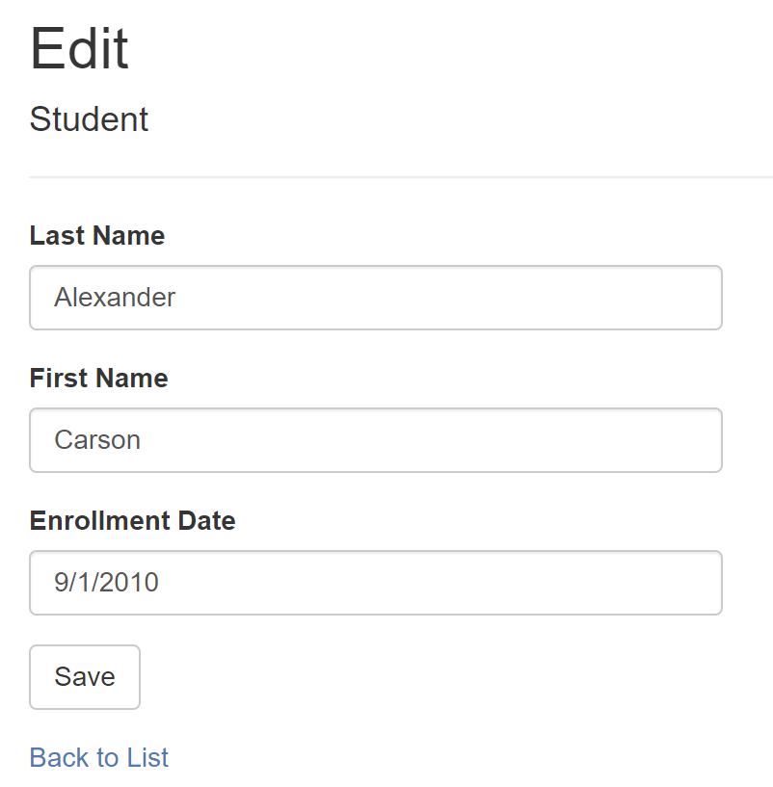
Model-Bound Types

Slide 48
Task-Based UIs
Transfer
Student Details
Request
Handler
Response
Transfer
Correct
Schedule
…
…
…
…
…
…
…
Correct
Request
Handler
Response
Schedule
Request
Handler
Response

Slide 49
Modeling Command Responses
Command
Handler
Response

Slide 50
Void Response
Command
Handler
IRequest

Slide 51
Command Result Response
Command
Handler
T
IRequest<T>

Slide 52
Success/Fail
Command
Handler
true/
false
IRequest<bool>

Slide 53
Creation
Create
Handler
Id
IRequest<Guid>
302 Found
/orders/081bcba7-89ff-4a41-af90-ded095160b99

Slide 54
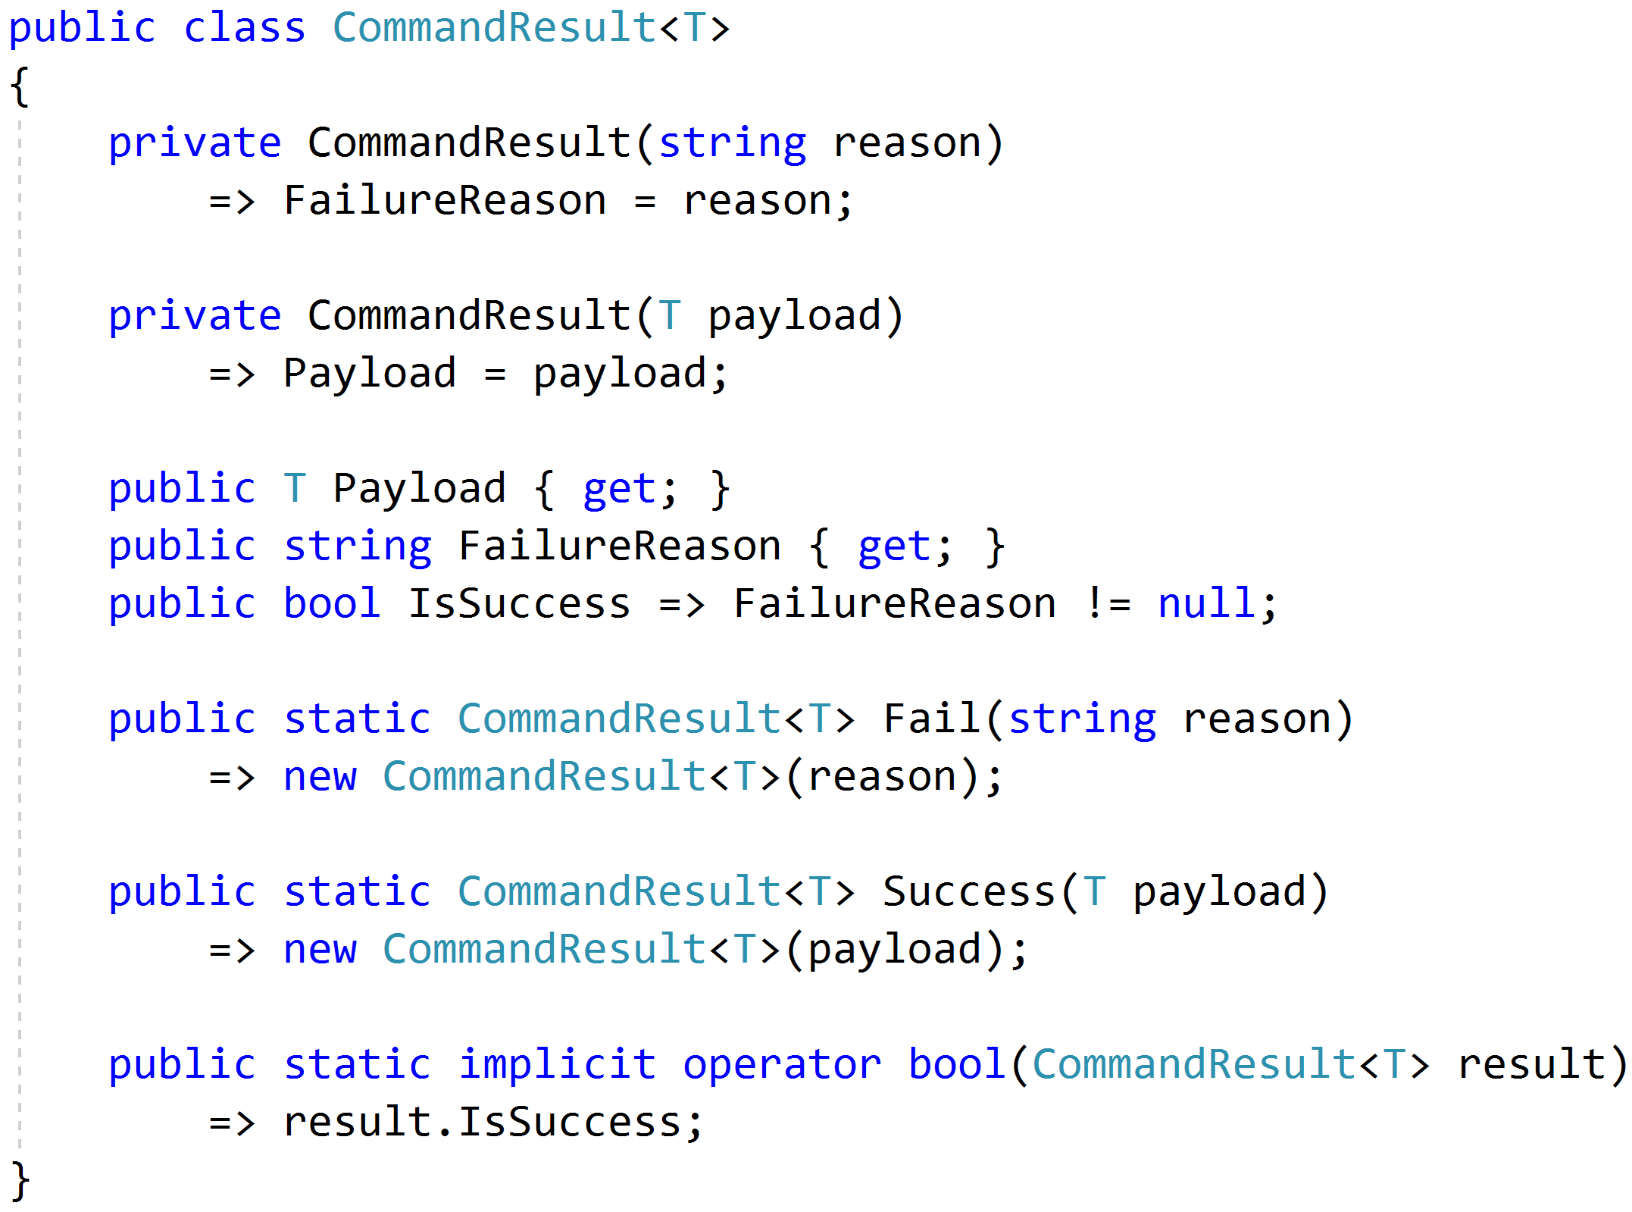
Complex Response

Slide 55
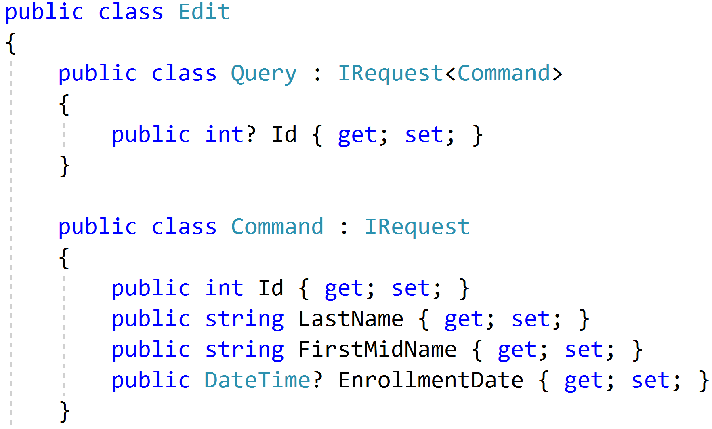
Command/Query Duality

Slide 56
Command Handlers
Command
Handler
Response

Slide 57
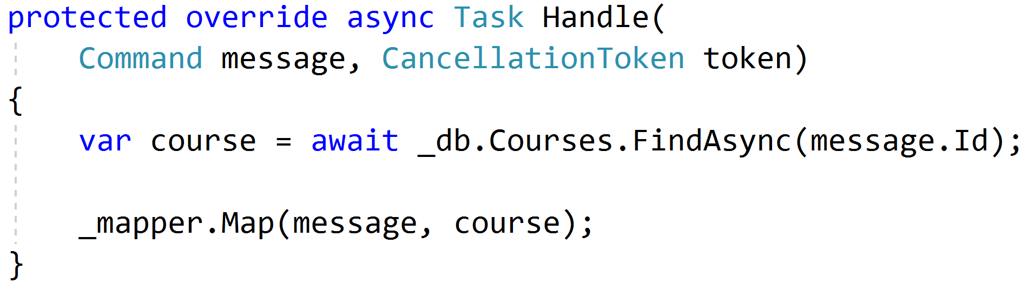
Procedural Beginnings

Slide 58
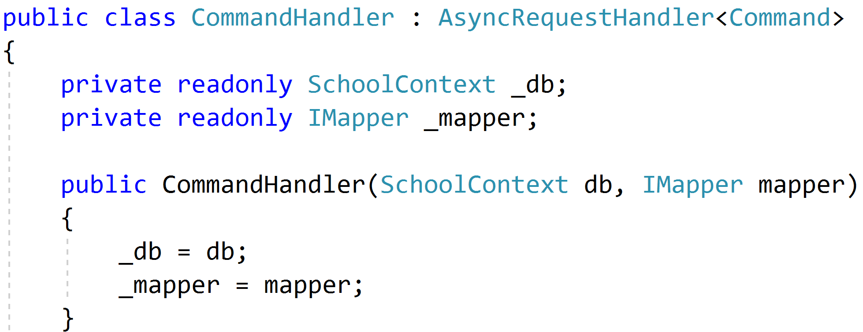
DI with no abstractions

Slide 59
Complexity?

Slide 60
Don't Panic!

Slide 61
Red
Green
Refactor

Slide 62

Code Smells
Large Class
Extract Class
Extract Subclass
Extract Interface
Replace Method
with Method Object
Compose Method
Extract Method
Move Method
Long Method

Slide 63

Behavioral Smells
Combinatorial Explosion
Conditional Complexity
Feature Envy
Inappropriate Intimacy
Duplicated Code

Slide 64
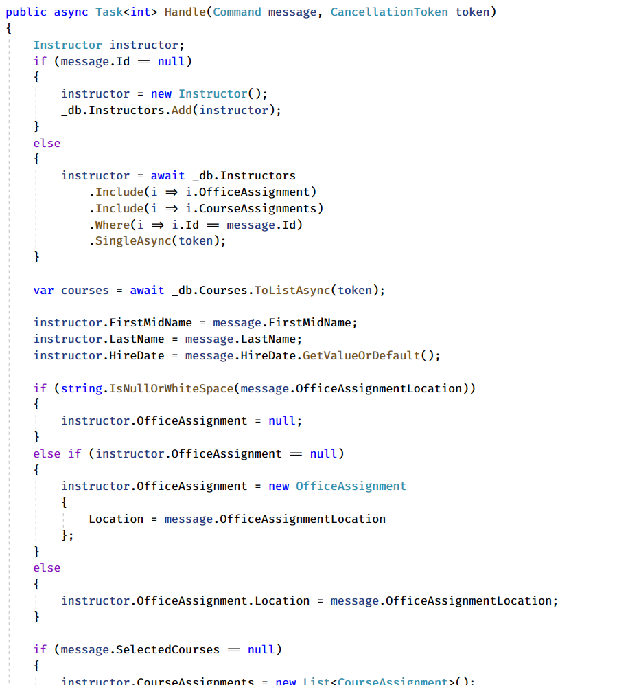
Large Method!
Request
Handler
Domain
Response

Slide 65
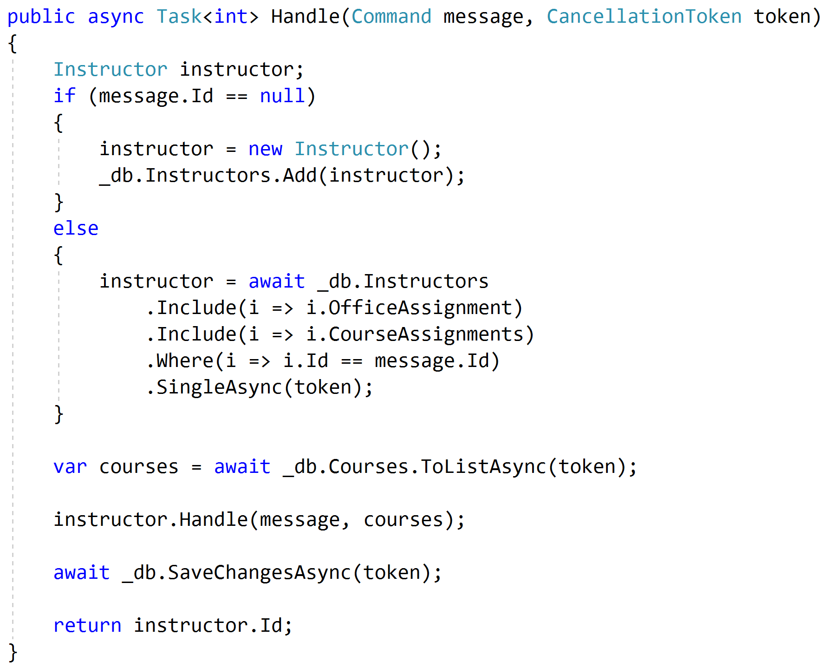
Push Behavior Down
Request
Handler
Domain
Response

Slide 66
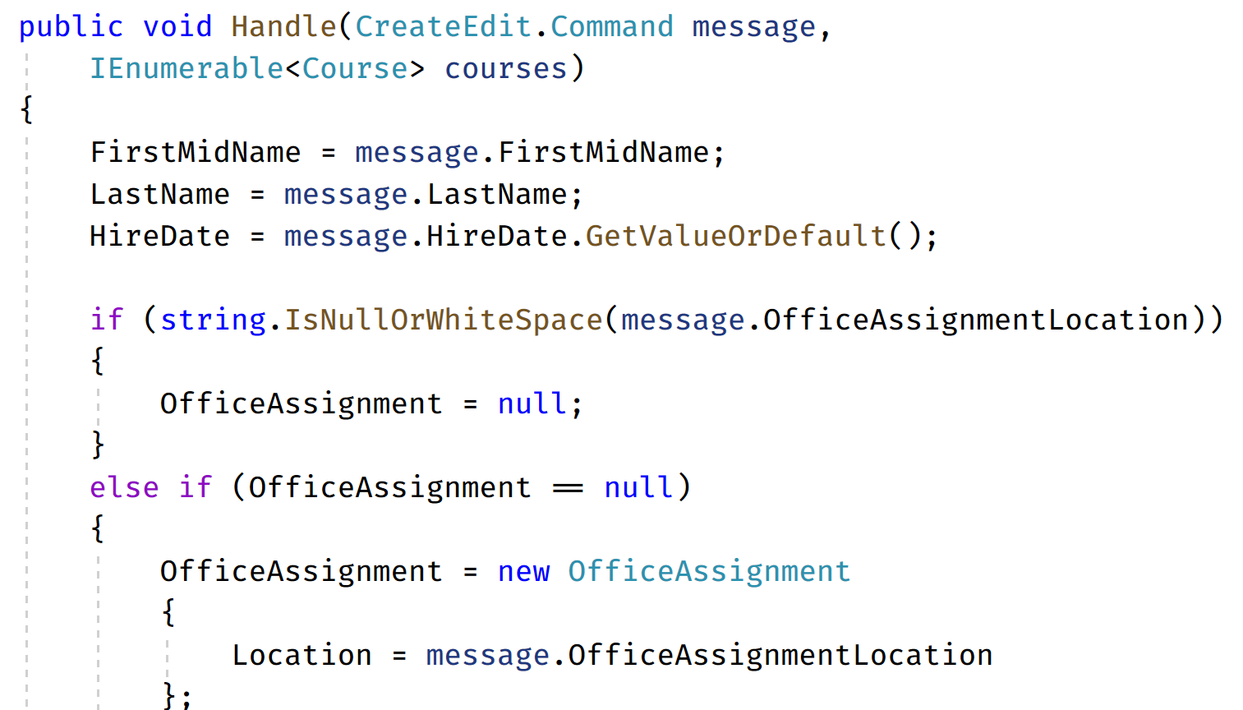
Code Smells (again)
Request
Handler
Domain
Response

Slide 67
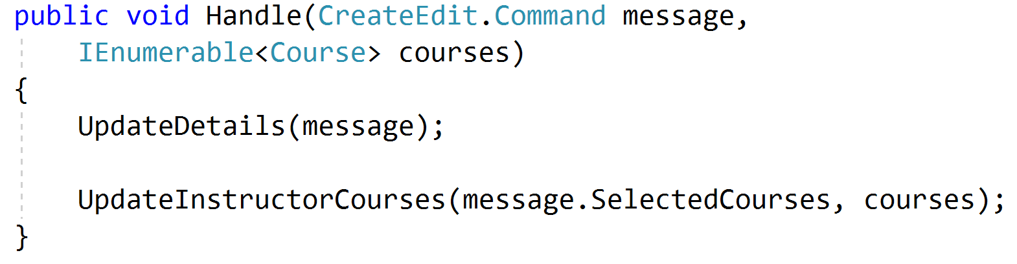
Refactored Toward Encapsulated Domain
Request
Handler
Domain
Response

Slide 68
Validation?

Slide 69
Validation Scopes
Command Validation
Domain Model
Request Validation
Request
Database
External Models

Slide 70
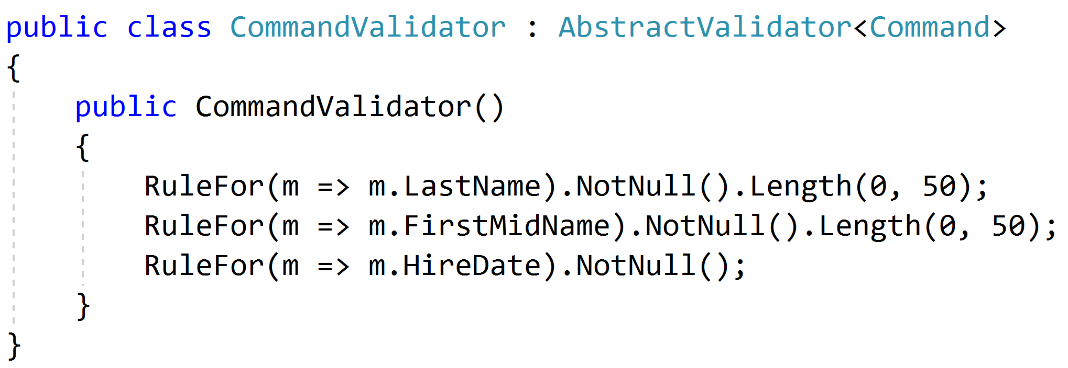
Request Validation

Slide 71
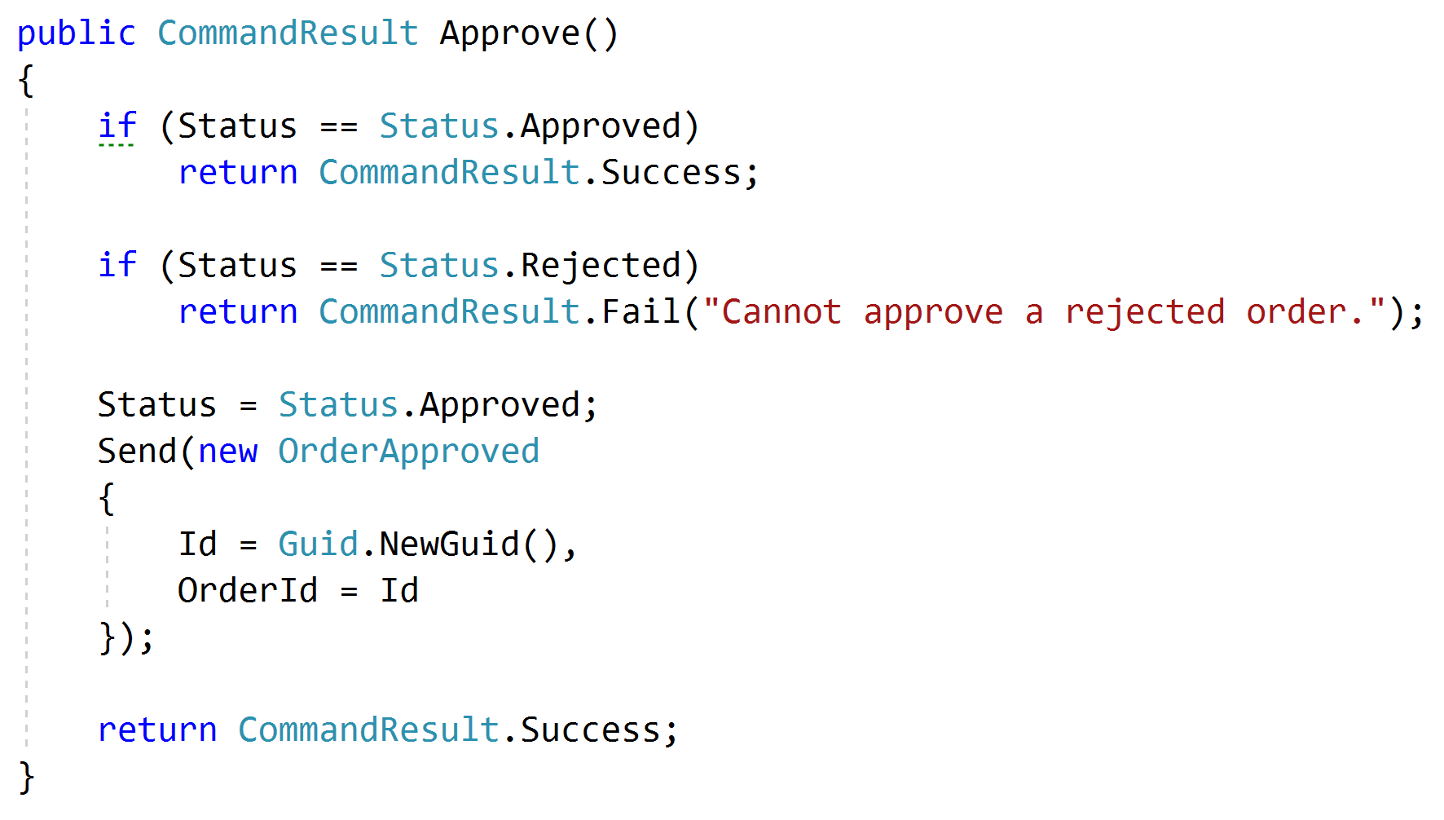
Domain Validation
Request
Handler
Domain + Validation
Response

Slide 72
Representations
Query
Handler
Response
????

Slide 73
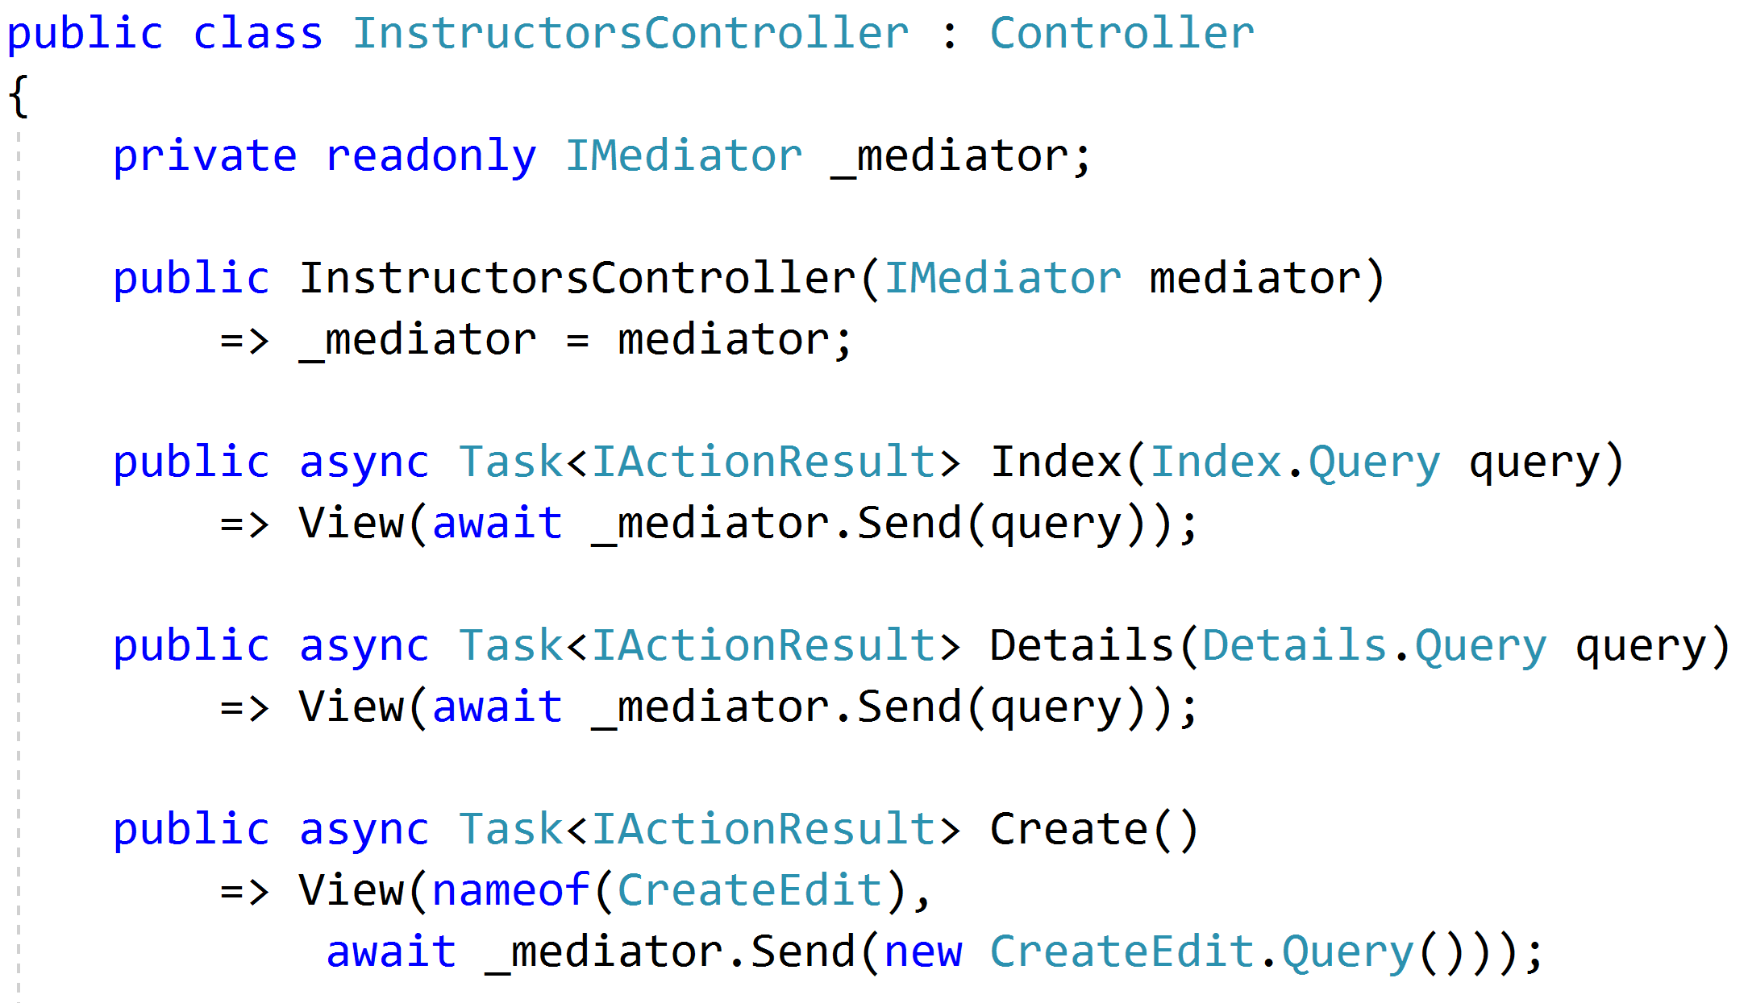
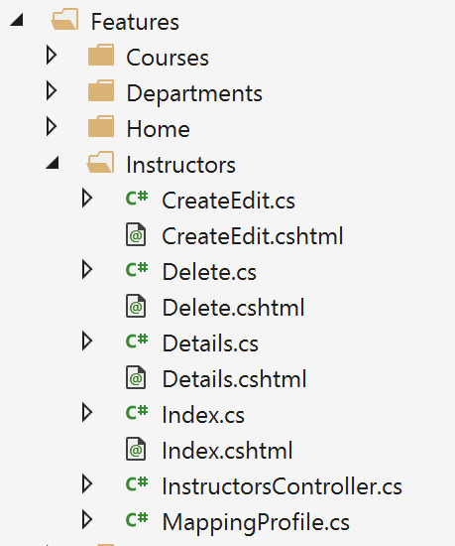
Controllers as routes

Slide 74
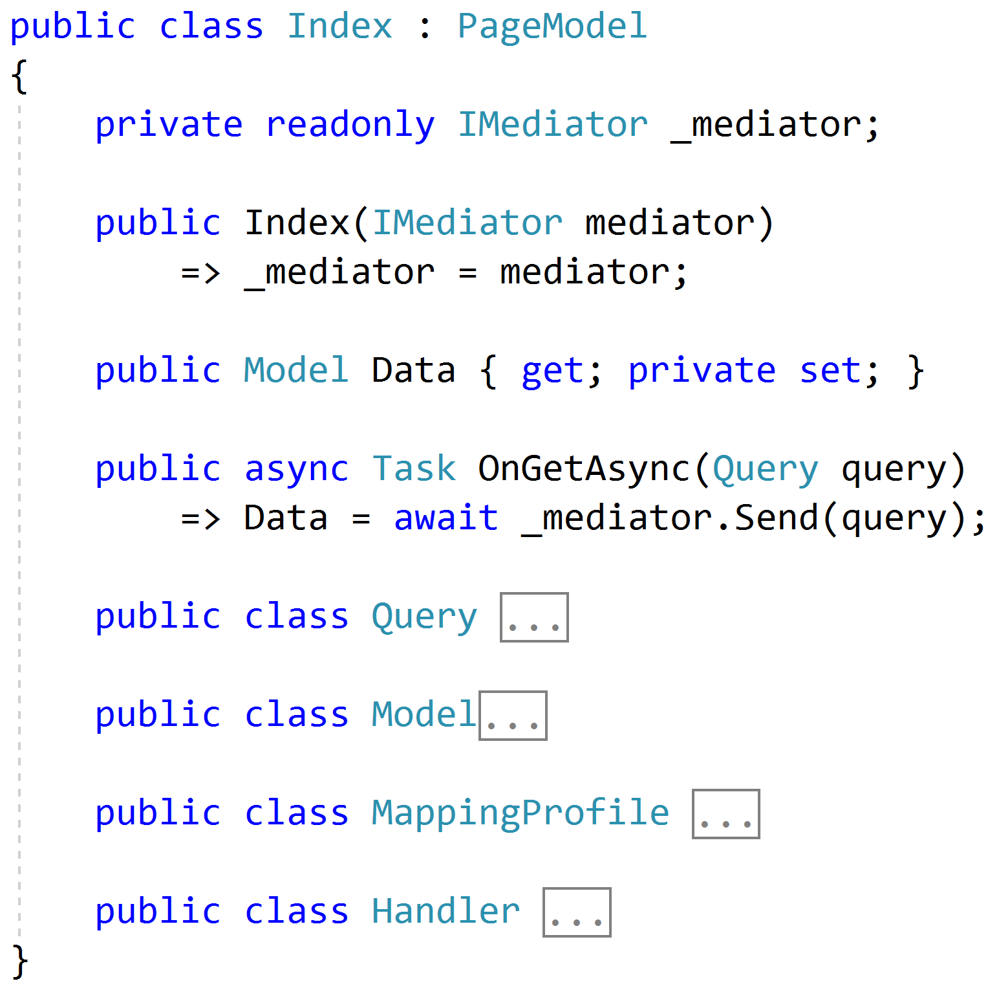
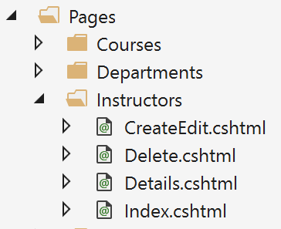
Razor Pages

Slide 75
Web APIs
/order/approve
Handler
/order/reject
Handler
Order json
/order/hold
Handler
/order/cancel
Handler
SPA

Slide 76
Cross-Cutting Concerns
Duplication
Request
Handler
Response

Slide 77
Pipeline Behavior (Decorator)
Pipeline Behavior
Request
Handler
Response

Slide 78
Stackable Decorators
Pipeline Behavior
Pipeline Behavior
Pipeline Behavior
Handler

Slide 79
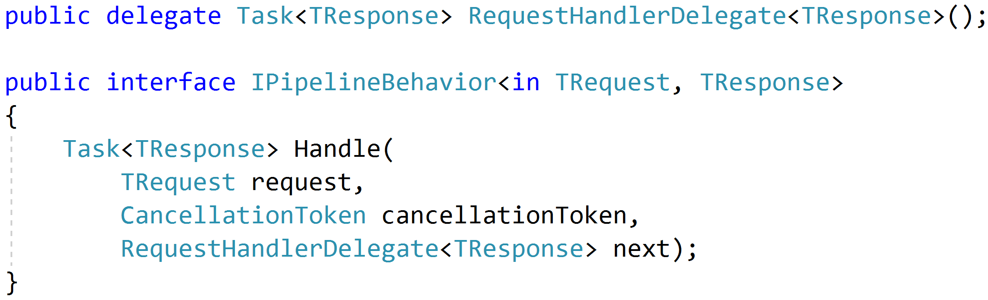
Think: Action Filters

Slide 80
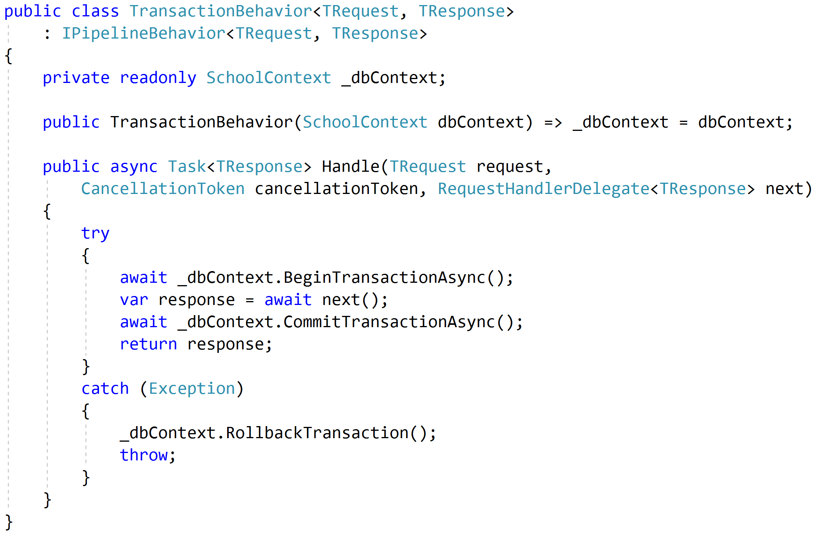
Transactions

Slide 81
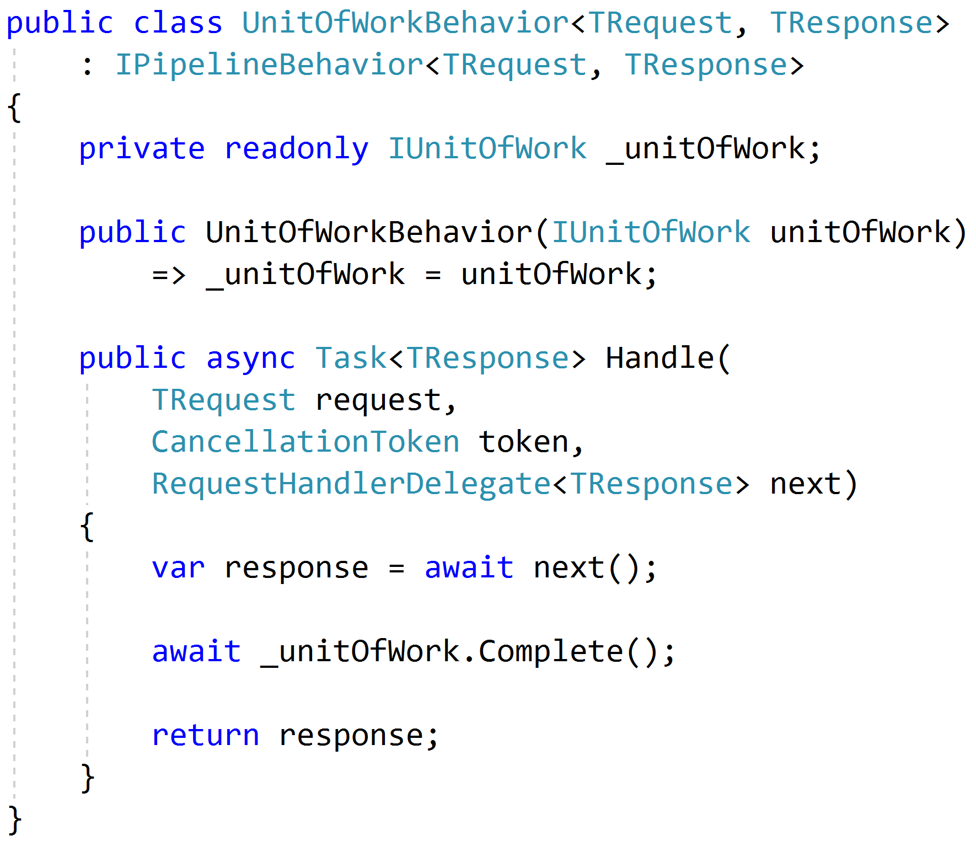
Unit of Work

Slide 82
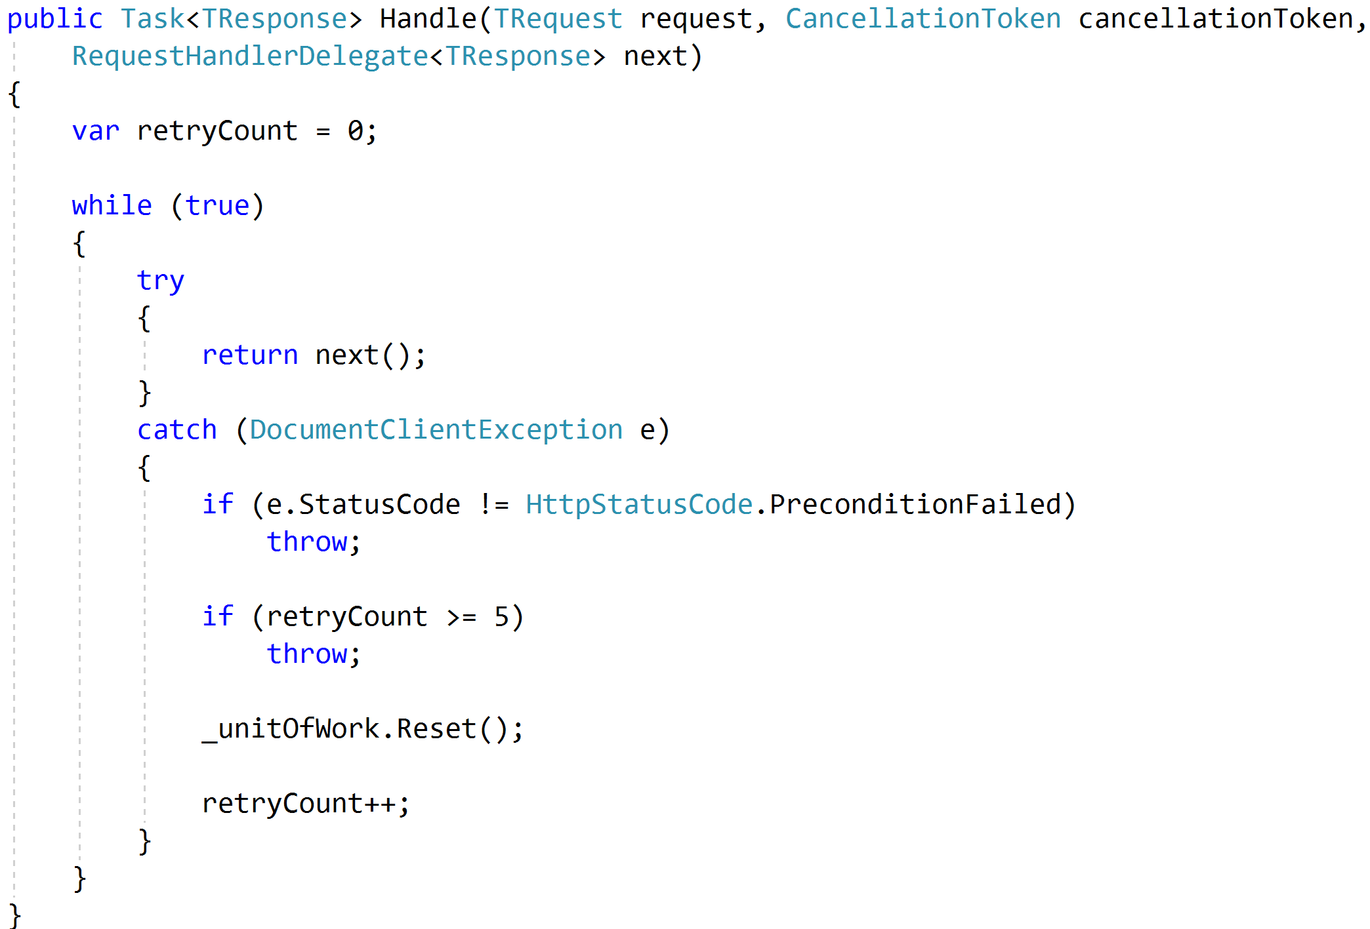
Concurrency and Retries

Slide 83
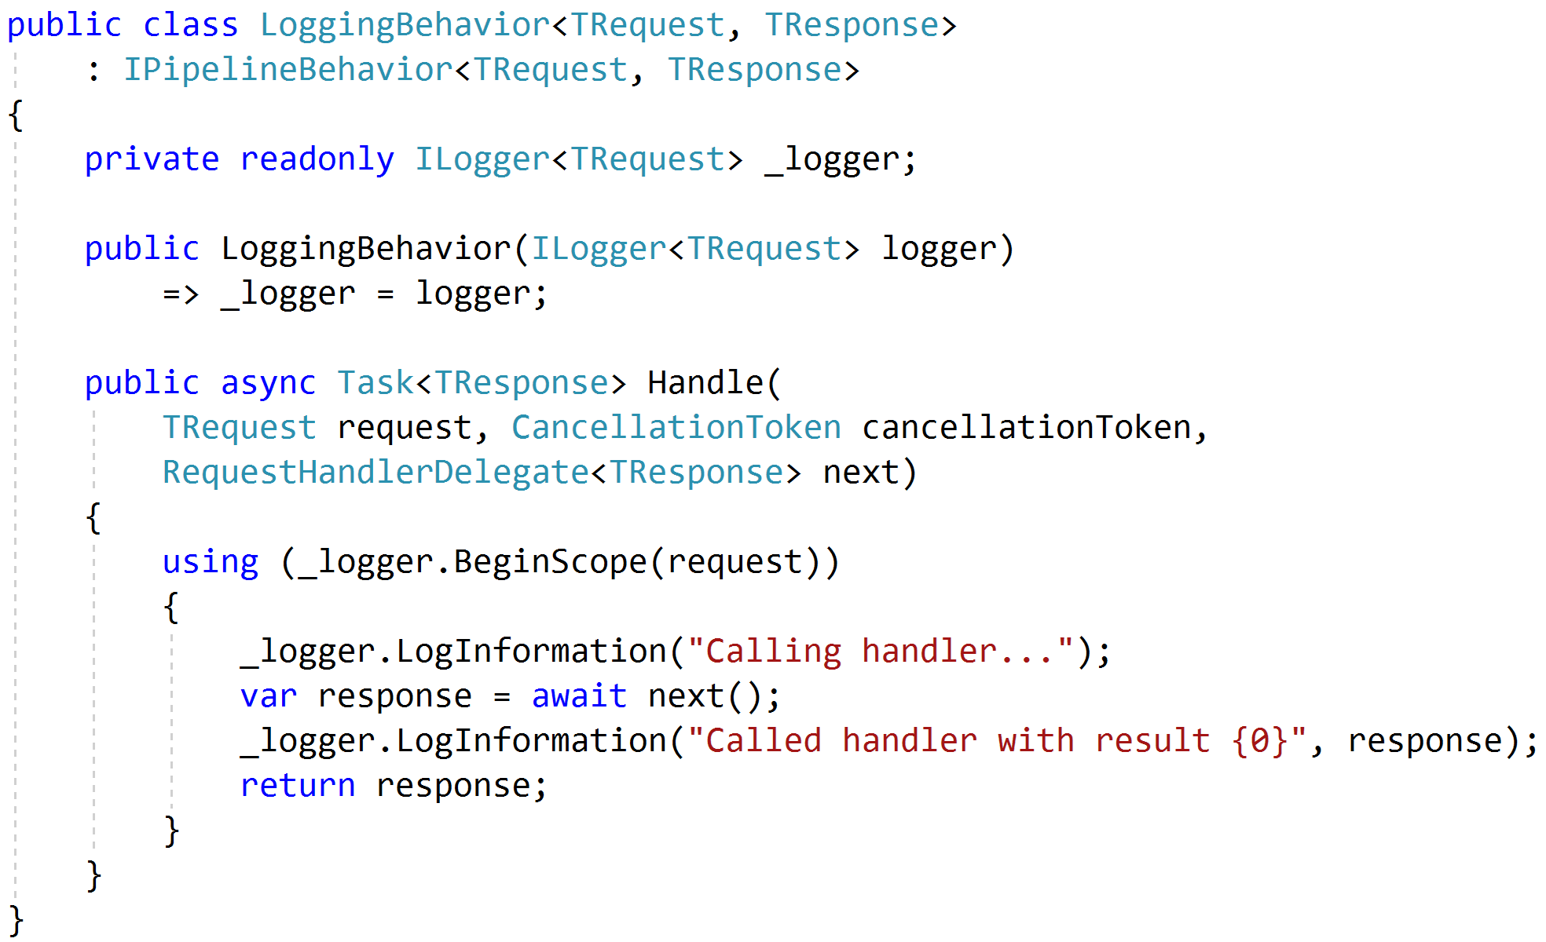
Logging

Slide 84
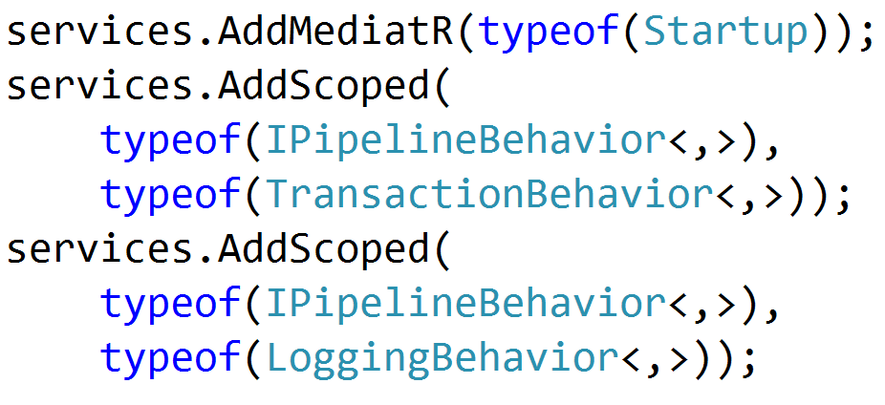

Registration

Slide 85
Architecture in slices
Validation
Domain Agnostic
Authentication
Authorization
Feature
Feature
Feature
Feature
Feature
Feature
Feature
Feature
Feature
Feature
Feature
Feature
Feature
Feature
Domain Specific
Persistence

Slide 86
Testing
Pipeline Behavior
Pipeline Behavior
Pipeline Behavior
Request
Handler
Response
Arrange
Assert
Act

Slide 87
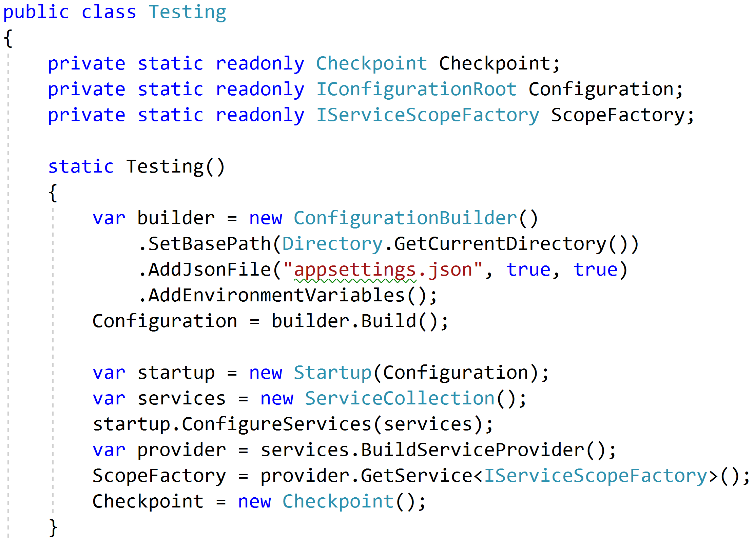
Reproduce Reality

Slide 88
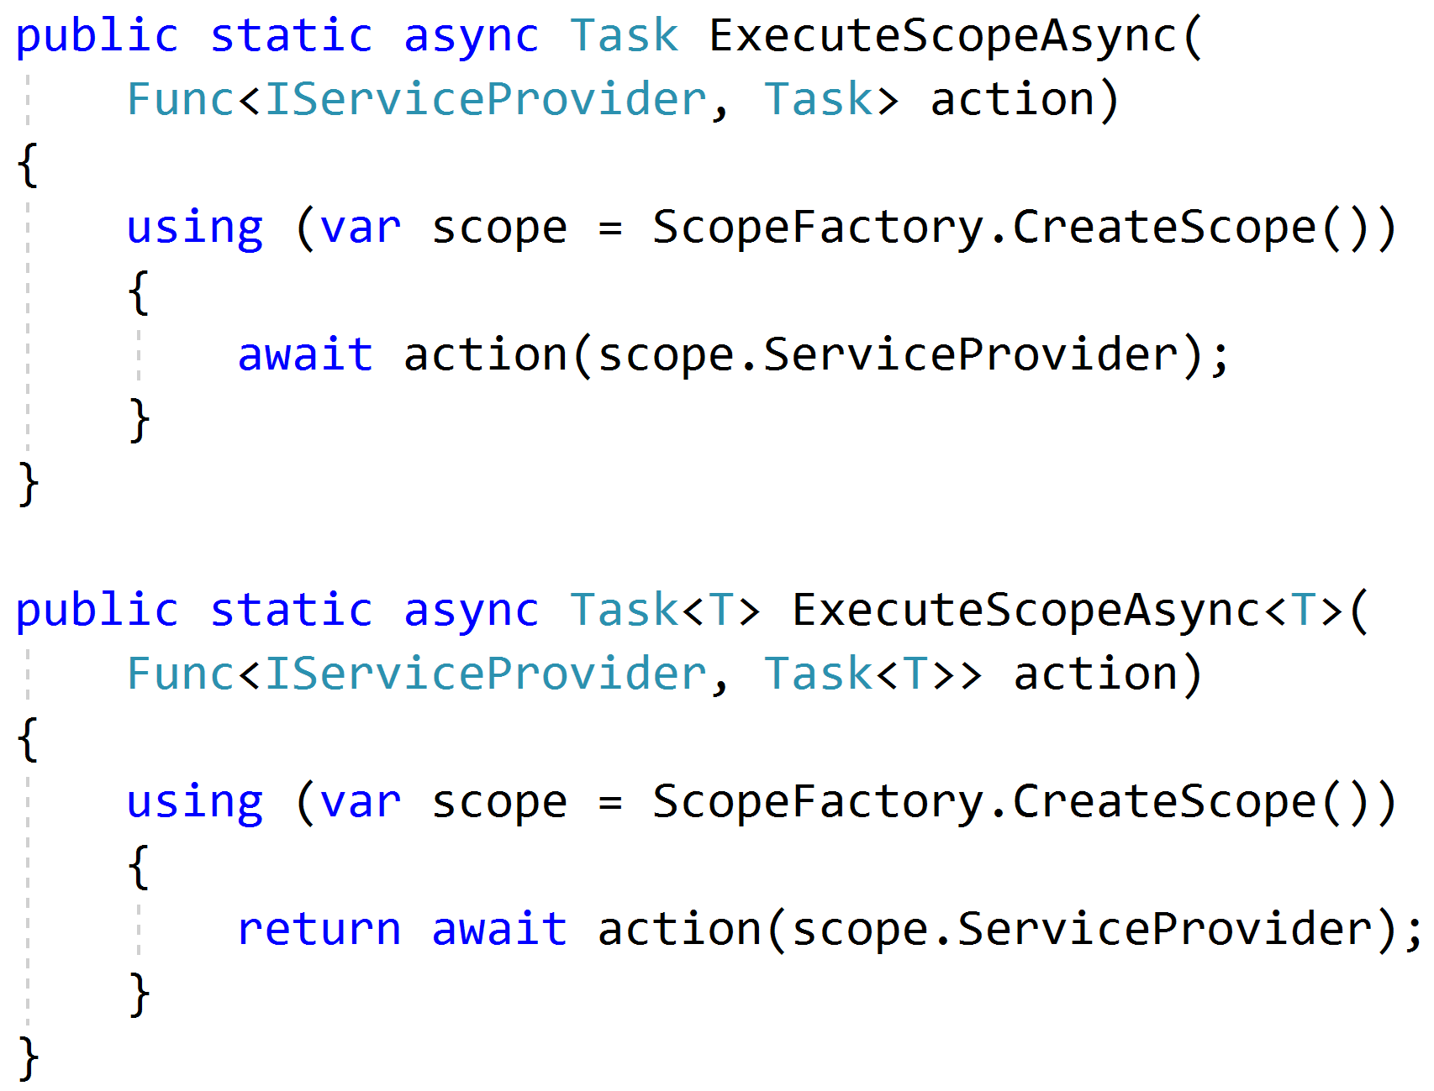
Mimicking Scoped Requests

Slide 89
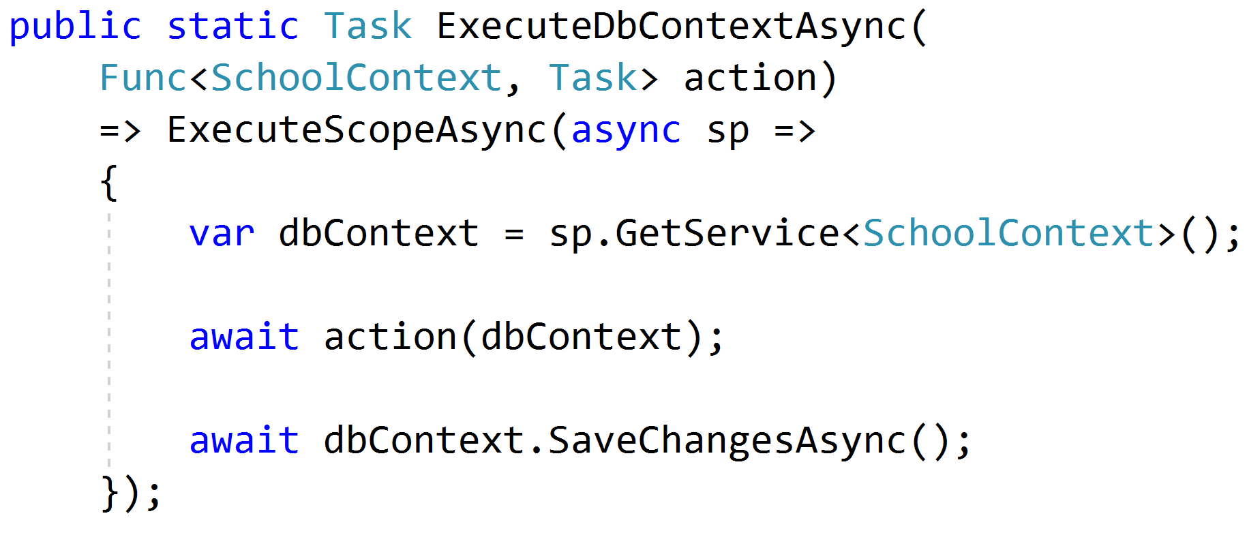
Setting Up Data

Slide 90
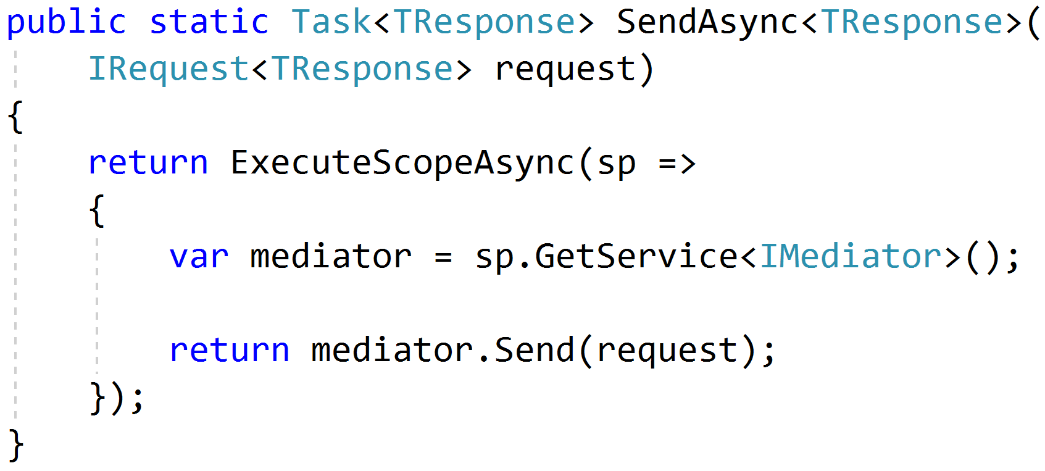
Sending Requests

Slide 91
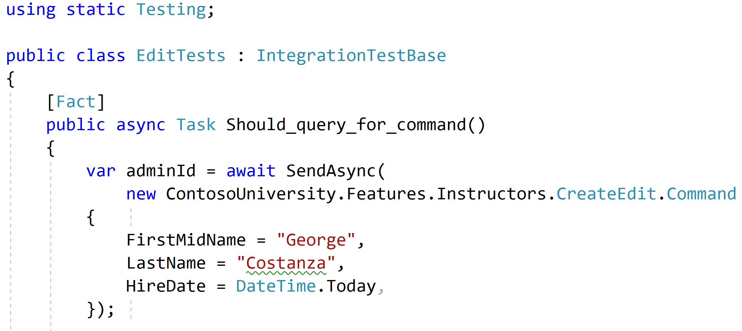
Using static helpers

Slide 92
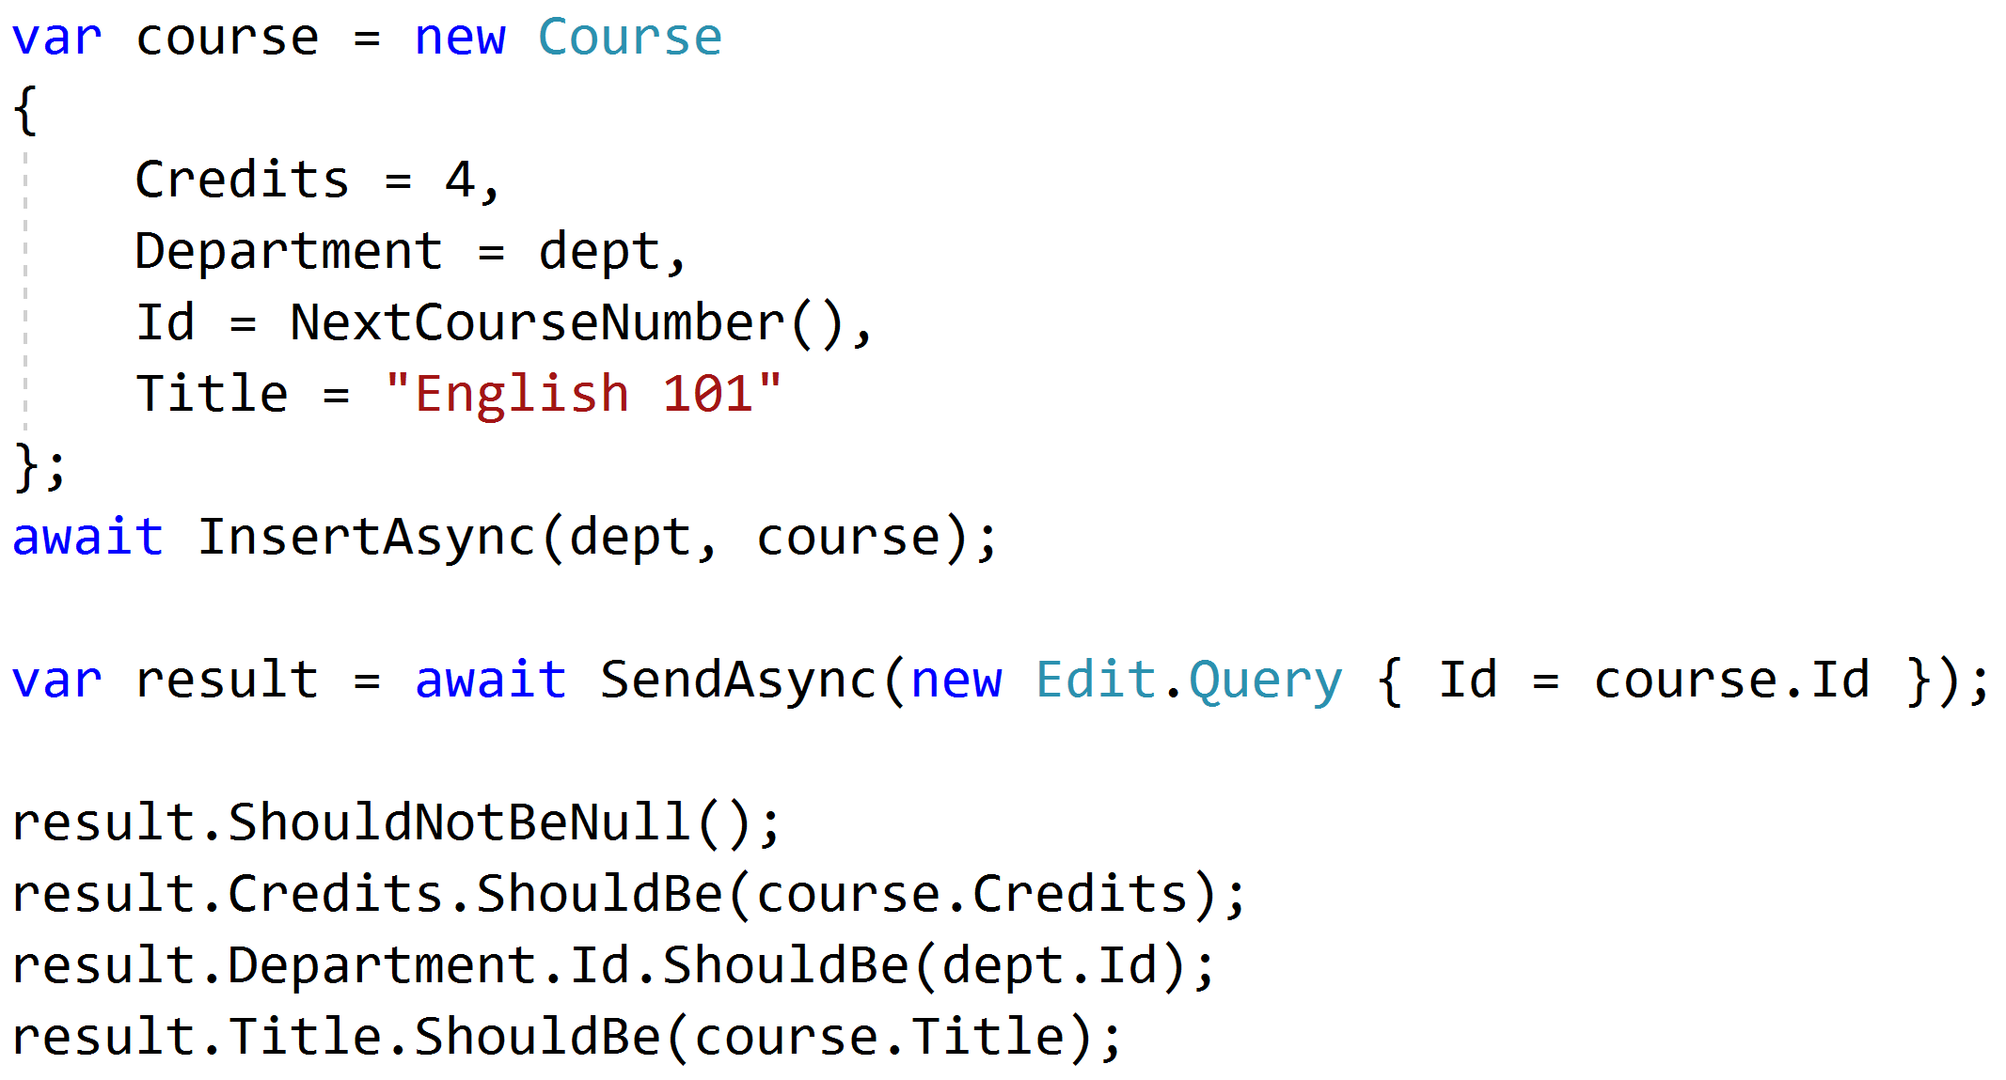
Testing queries through result

Slide 93
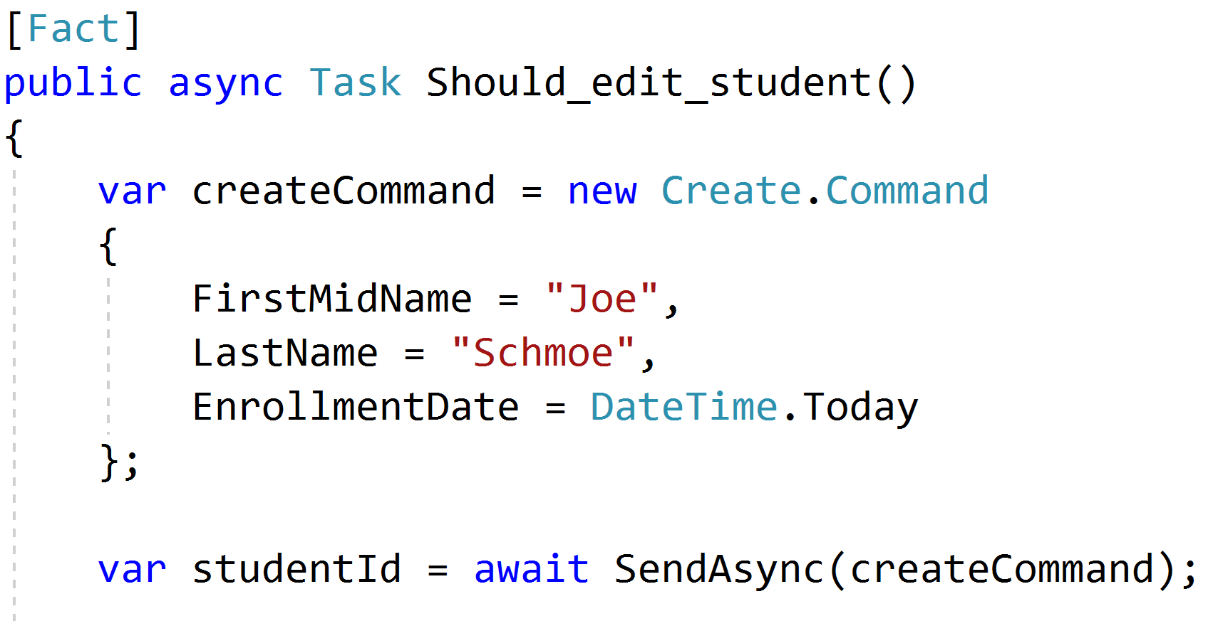
Setup through the front door

Slide 94
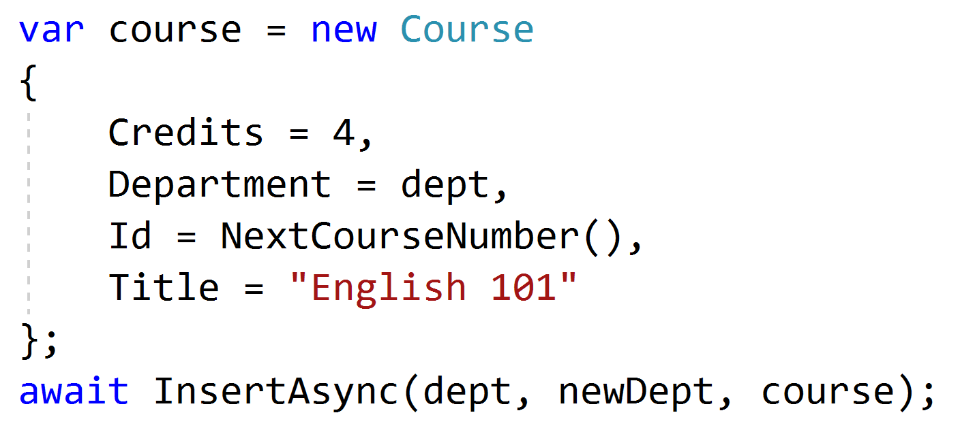
Setup data directly when needed

Slide 95
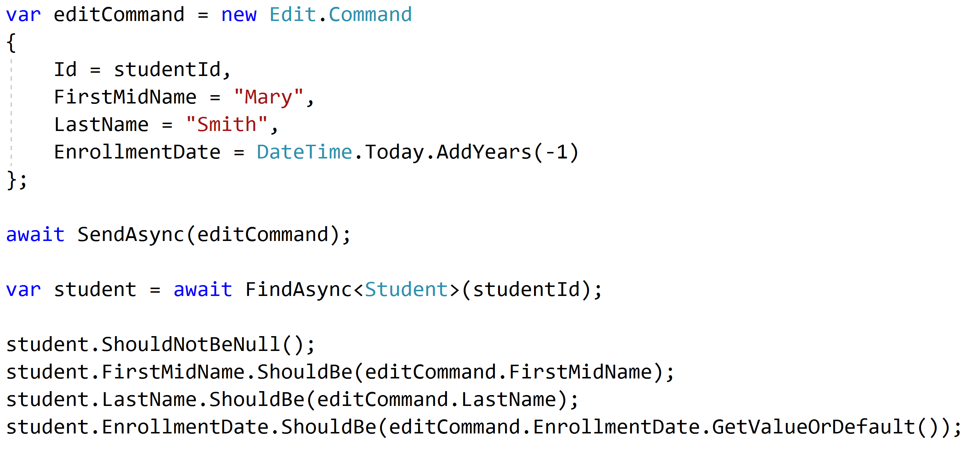
Test commands with roundtrips

Slide 96
Unit and Integration Tests
Pipeline Behavior
Integration Tests
Pipeline Behavior
Pipeline Behavior
Handler
Rich Domain Model
Unit Tests

Slide 97
Key Takeaways
Vertical slices makes code easy to add/change/delete
Do not skip refactor!
Push behavior down
Integration test handlers, unit test domain

Slide 98


Vertical Slice Architecture
Jimmy Bogard
@jbogard
github.com/jbogard/presentations
bit.ly/2tIFoov
jimmybogard.com

